Slide 1

PHP
CHAPTER 2 – PHP WEB SERVER

Slide 2







TODAY
PARAMETERS
WEB SERVER
CLIENT
URL ANATOMY
REQUEST
WEB
FORMS
EXECUTE PHP CODE
MANUPULATE
DATA
RESPONSE
WEB COOKIES
GENERATE HTML
INCLUDE
OTHER PHP FILES

Slide 3

OBJECTIVES FOR TODAY
Anatomy of a URL
Send a request with parameters
Catch the request : $GET Superglobal
Check if value exist: isset
Include another PHP :include_once
Link from 1 page to another page

Slide 4

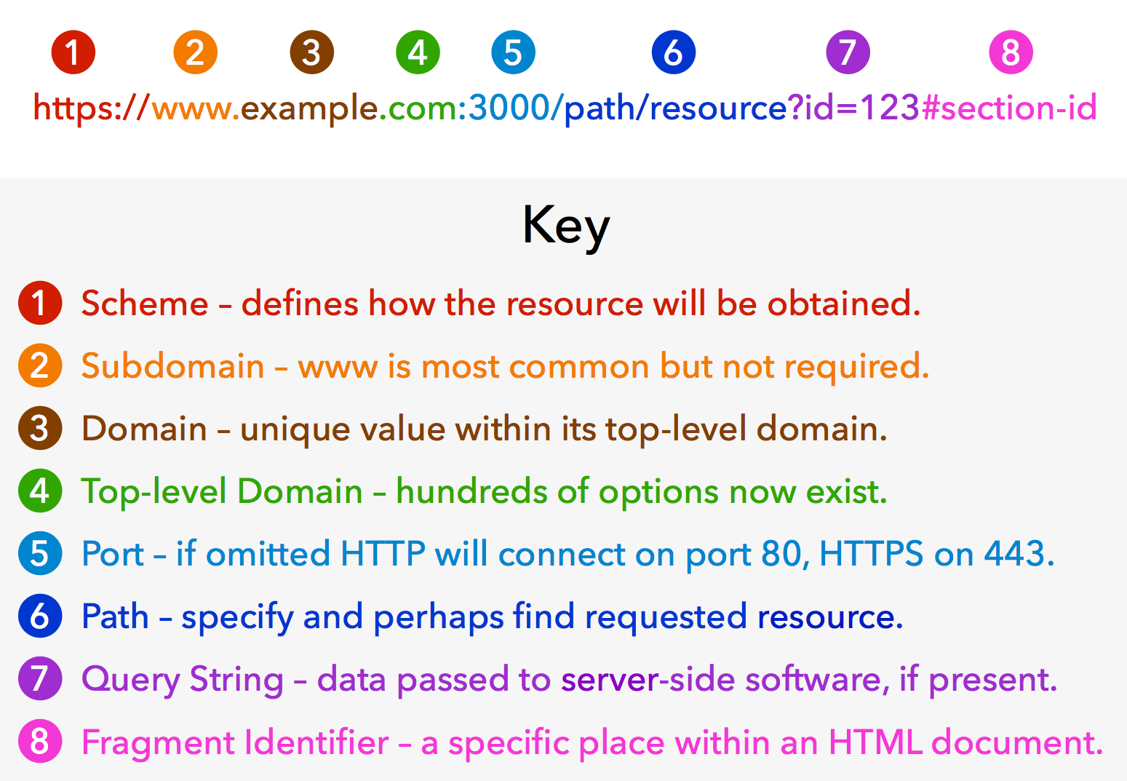
PRESENTATION
URL Anatomy
CLASS

Slide 5

PRESENTATION
URL Anatomy – DEFAULT VALUES
CLASS
If not specified:
If not specified:
index.html
http = 80
or
index.php
https = 443

Slide 6


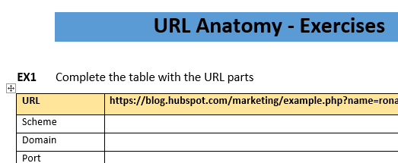
ACTIVITY
ACTIVITY 1 - URL Anatomy
10 MIN
TWO
Complete the word document

Slide 7
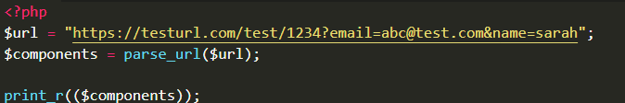
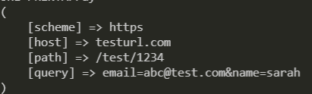
ACTIVITY
ACTIVITY 2 – PARSE URL
10 MIN
TWO
Run activity2 php file
Change the URL and check the associative array contains the new values

Slide 8








PRESENTATION
CLASS
HTTP GET request is used to:
request a resource from the server
CLIENT
SERVER
GET www.example.com
www.example.com

Slide 9

PRESENTATION
PHP - SuperGlobals
CLASS
Always accessible
Anywhere in the code
$_REQUEST
$_GET
$_SERVER

Slide 10
PRESENTATION
CLASS
PHP super global
to collect data from a GET
$_GET
GET https://hello.com?subject=peter&web=“pnc”

Slide 11
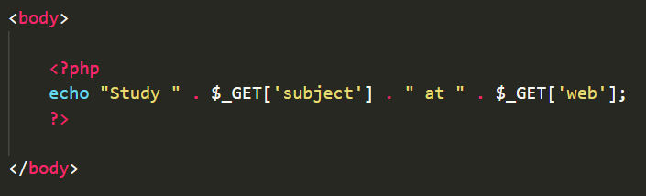
ACTIVITY
ACTIVITY 3 – USE $GET
10 MIN
TWO
Run activity3 php file
Change the code to display 2 other data from the URL

Slide 12
Ternary operator
write your IF/ELSE in 1 line !
$a = 5;
$b = 6;
$message = "";
if ($a > $b) {
$message = "A";
} else {
$message = "B";
}
$a = 5;
$b = 6;
$message = ($a > $b)? "A" : "B";
CONDITION
IF
TRUE
IF
FALSE
SAME SAME BUT DIFFERENT

Slide 13

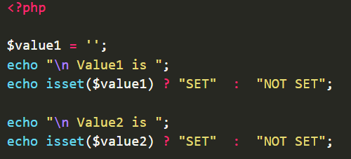
isset( <variable> )
Determines if a variable is declared and is different than null
What will this code produce ?

Slide 14

require_once
require_once statement includes and evaluates the specified file during the execution of the script.
require_once(‘<file path>');

Slide 15
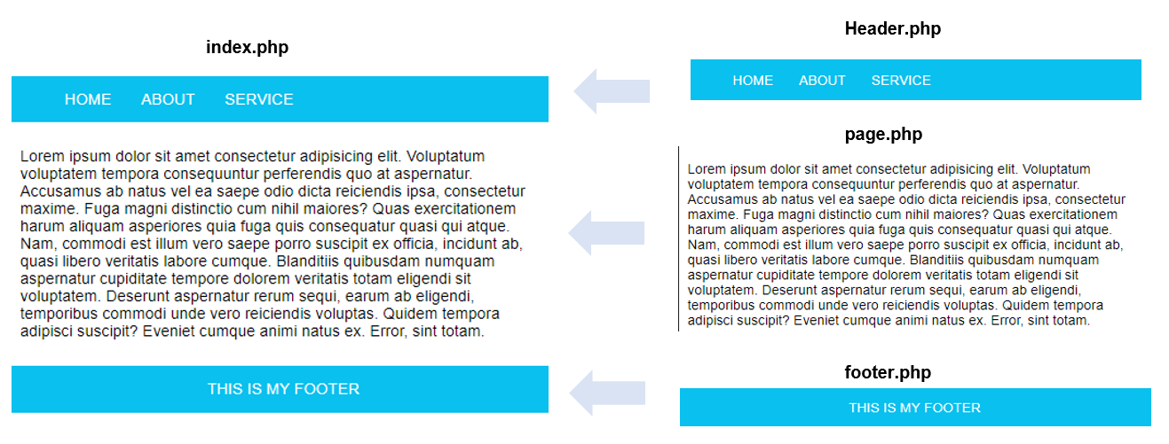
ACTIVITY
ACTIVITY 5 – Include Header, home, footer
10 MIN
TWO
Open index.php file
Include the 3 files: header, home, footer

Slide 16
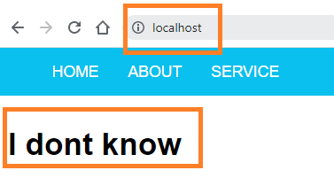
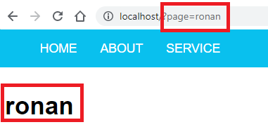
ACTIVITY
ACTIVITY 6 – Get query parameter
10 MIN
TWO
Open home.php file
Check if the query parameter "page" exists on the URL
- If YES display it
- If NO display ‘I don’t know

Slide 17
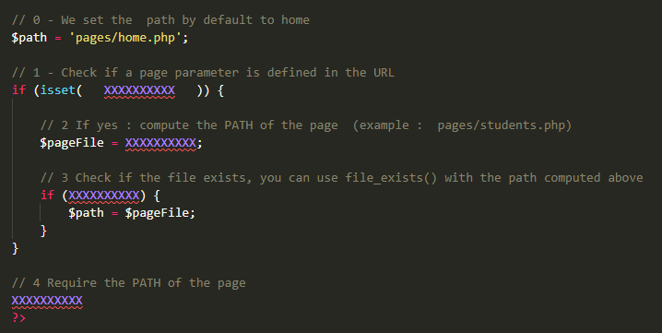
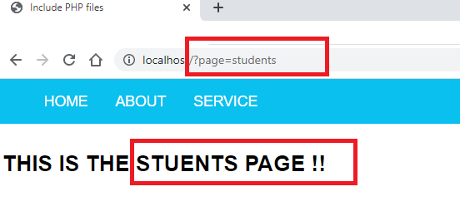
ACTIVITY
ACTIVITY 7 – Display page from query parameter
10 MIN
TWO
Open index.php file
Replace XXX with the correct code
Test your code with different pages

